Slide 1
Stacking And Blending Ensemble Technique
Problem: It has probability to overfit.
Solutions: There are two solutions to reduce overfit. They are:
Hold out approach or Blending.
K-Fold approach.

Slide 2
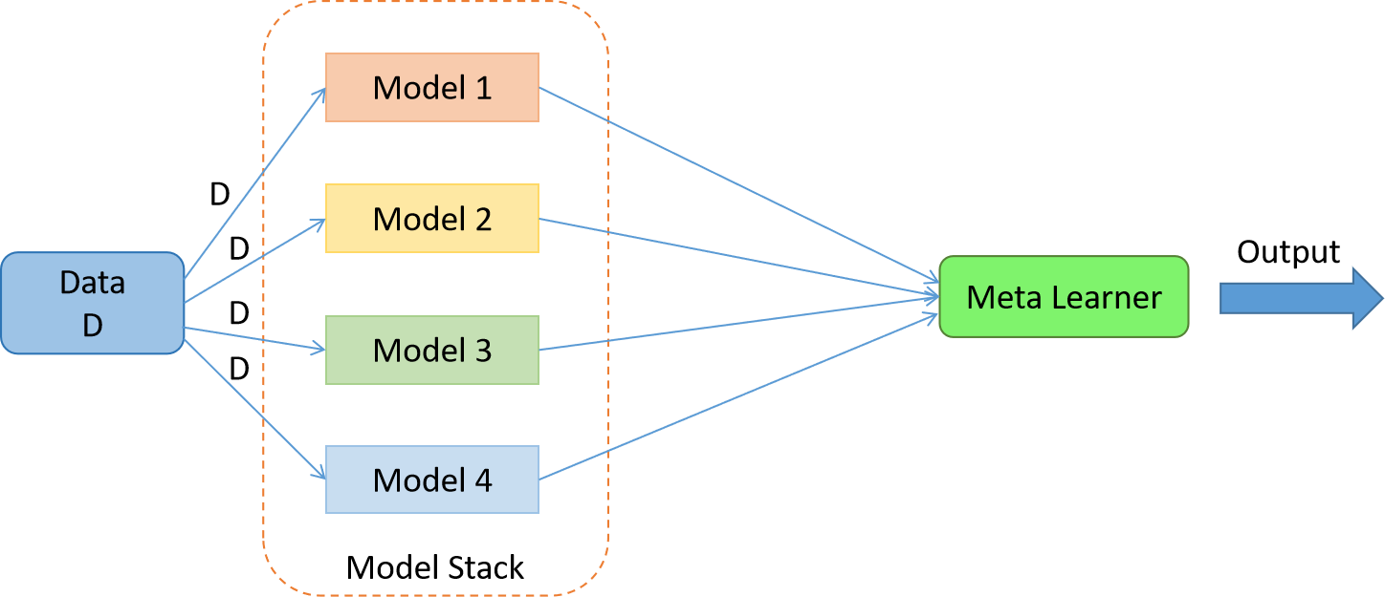
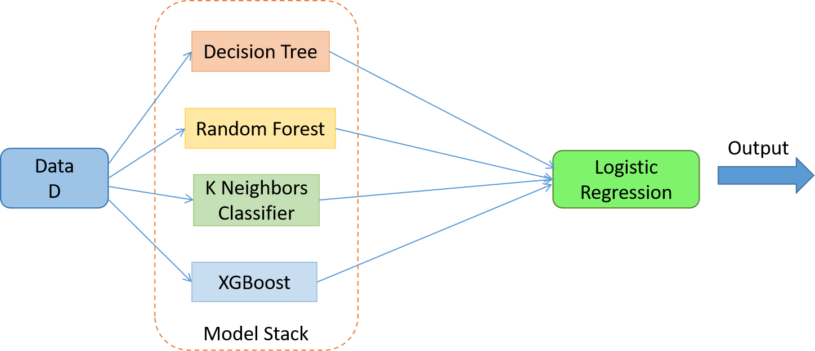
Stacking And Blending Ensemble Technique

Slide 3
Hold out approach or Blending
Dataset Operations:
Our model structure:
Main dataset
Suppose, 1000 rows
Divide it in 80:20 ratio
m1
LR
D-train (800 rows)
D-test (200 rows)
m2
DTR
RFR
m3
KNNR
m4
Meta model
D-train2 (600 rows)
D-validation (200 rows)
Base model

Slide 4
Now we train our three base model using D-train data. And test those base model by D-validation data. When we test we will get some prediction output and using those output we can create a dataset like this.
2. Now, we will train our meta model using this new dataset and test the meta model using D-test data.
M1 prediction | M2 prediction | M3 prediction | Actual output
Some value | Some value | Some value | Actual value
Some value | Some value | Some value | Actual value
200 rows

Slide 5
K-Fold Approach
Dataset Operations:
Our model structure:
Main dataset
Suppose, 1000 rows
Divide it in 80:20 ratio
m1
LR
D-train (800 rows)
D-test (200 rows)
m2
DTR
RFR
200 | 200 | 200 | 200
Train | Train | Train | test
m3
KNNR
m4
Train | Train | test | Train
Meta model
Train | test | Train | Train
Base model
test | Train | Train | Train
Cross validation apply, k=4 just for example

Slide 6
First of all we will train our base model using D-train data based on K-Fold cross validation technique. In this cross validation every base model will be trained 4 times. And at last we will get below data:
Now, using the new data we will train our meta model.
Now, again will train our base model using full D-train data.
Again, we will test our base model using D-test data. And this will give some prediction or output. Those output will be gone to our meta model and meta mode will predict value.
M1 prediction | M2 prediction | M3 prediction | Actual output
Some value | Some value | Some value | Actual value
Some value | Some value | Some value | Actual value
800 rows

Slide 7
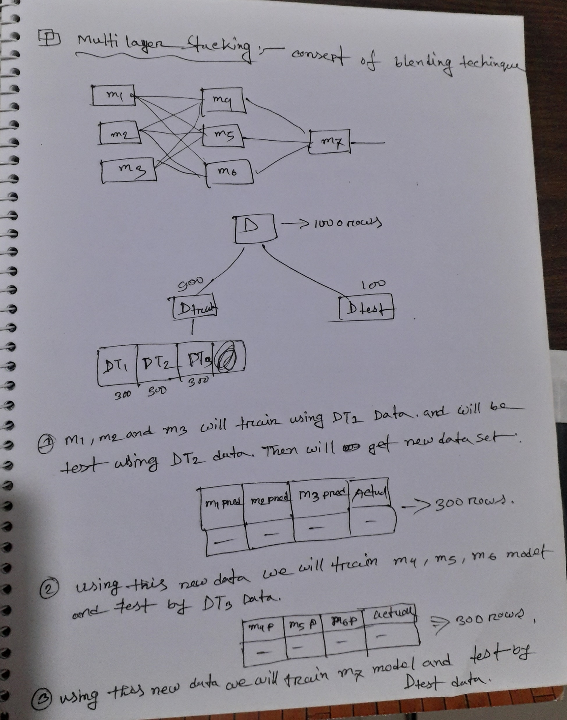
Multi layer Stacking (this is used blending technique)

